Slide 1

UNICORN ATTACK
Humayra Ahmed
Oakland University
April 14, 2021

Slide 2
Introduction
Instead of doing aliens, I decided to switch it up and do this project using unicorns!
Doing this project, I learned a lot about Python and Pygame and how it works.
This class was my first-time doing python in general and it was pretty fun!

Slide 3
Classes
Class
UnicornInvasion
Class
Unicorn(Sprite)
Class
Settings
Class
Scoreboard

Slide 4
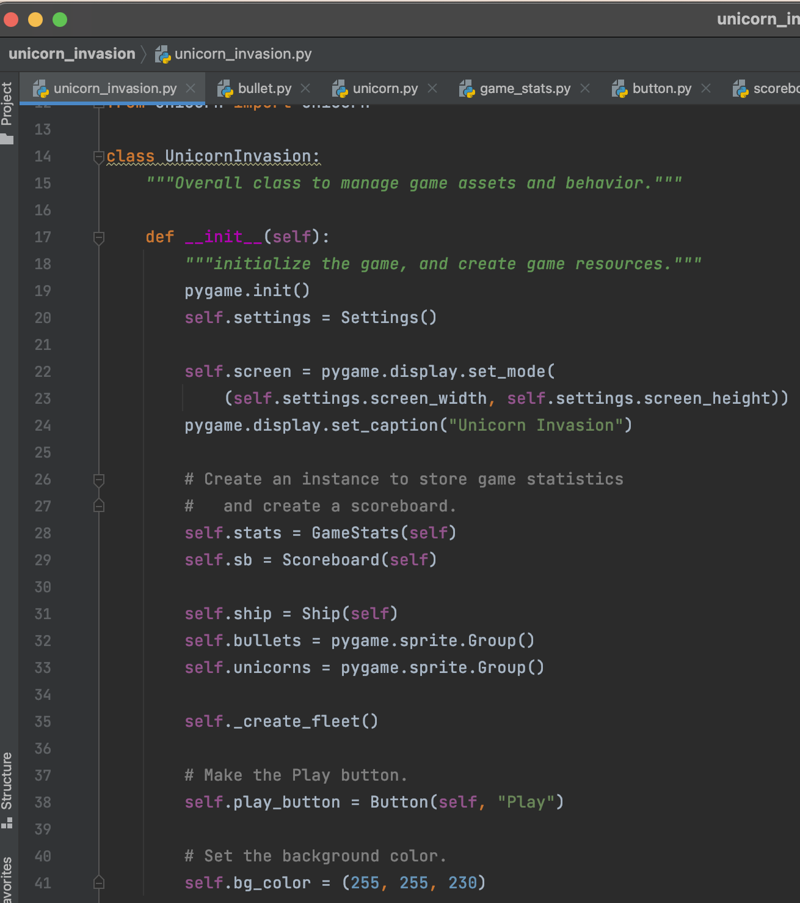
Class UNICORNInvasion
class UnicornInvasion: This class is to manage how the game runs and the assets. There’s code on how to change the directions, the keys to use when playing, how to fire and update bullets, and more.

Slide 5
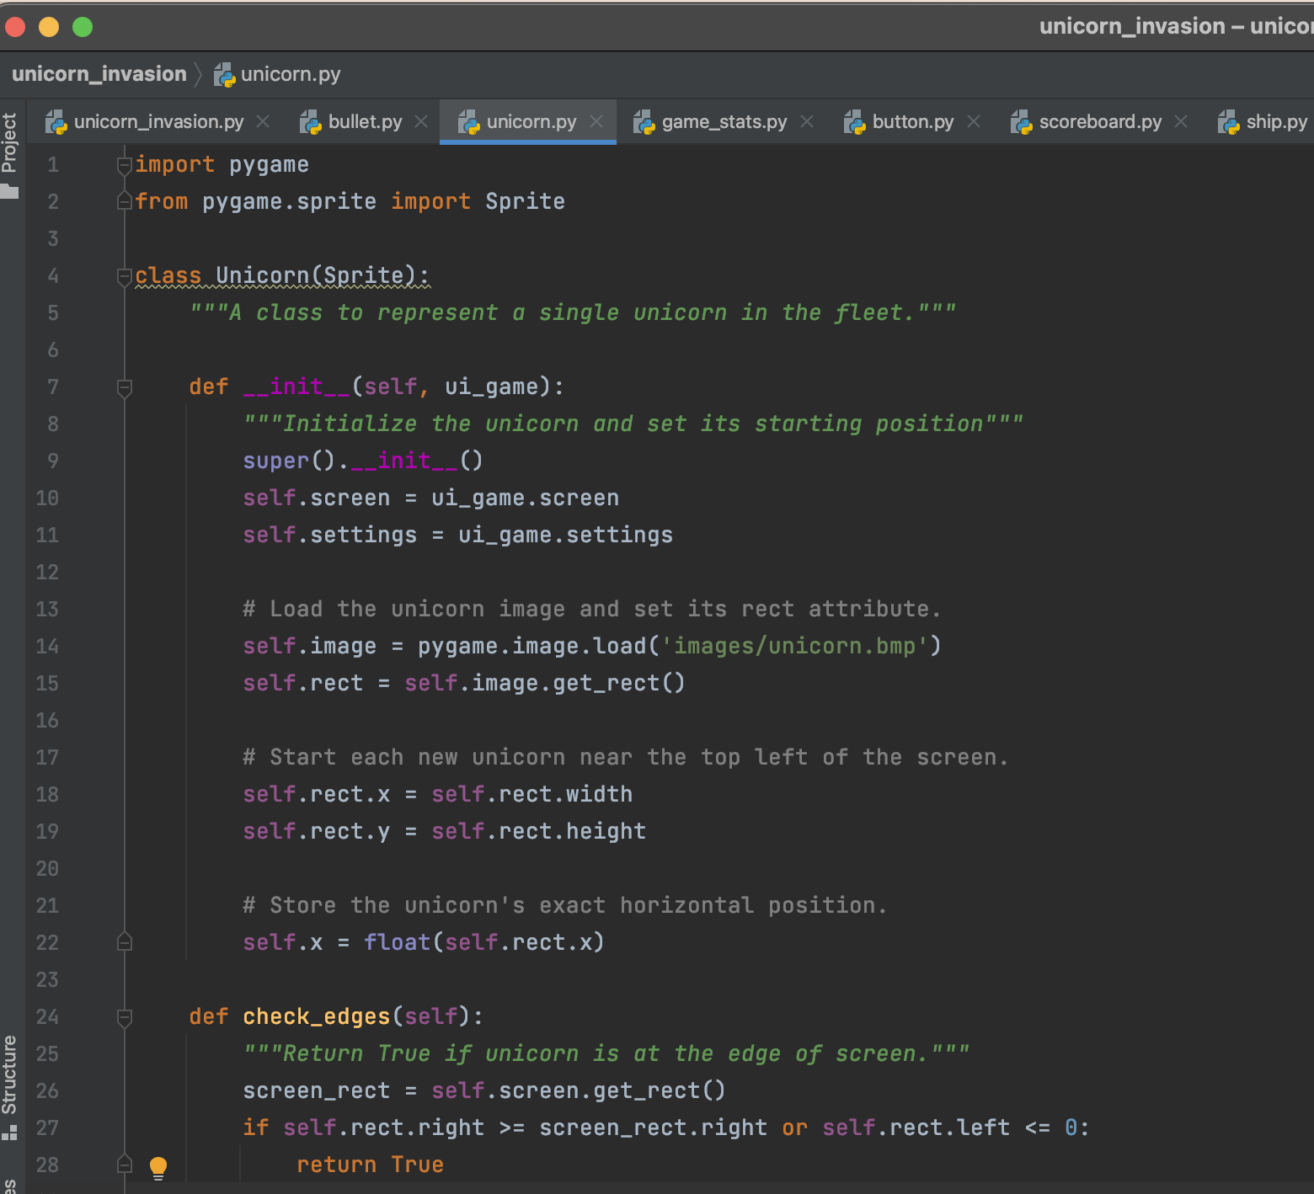
CLASS UNICORN(SPRITE)
class Unicorn(Sprite): This class is representing a unicorn in the fleet. It loads the image of the unicorn and where it should be placed.

Slide 6
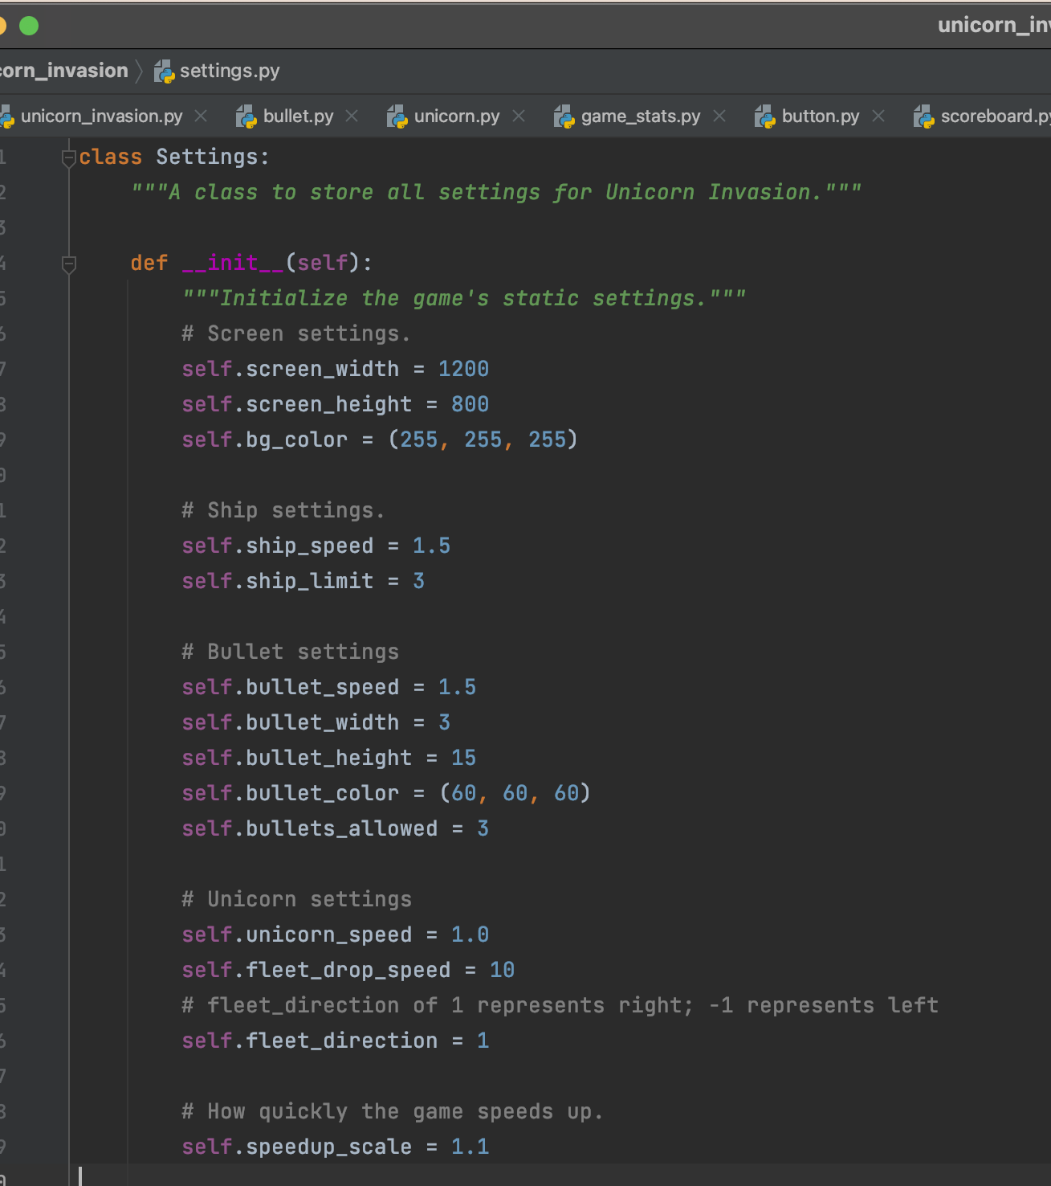
CLASS SETTINGS
class Settings: This class stores all the settings to Unicorn Invasion. It has the screen, ship, bullet, speed, and unicorn settings. It also has the code for how many points a player earns after the bullet hits the candy.

Slide 7
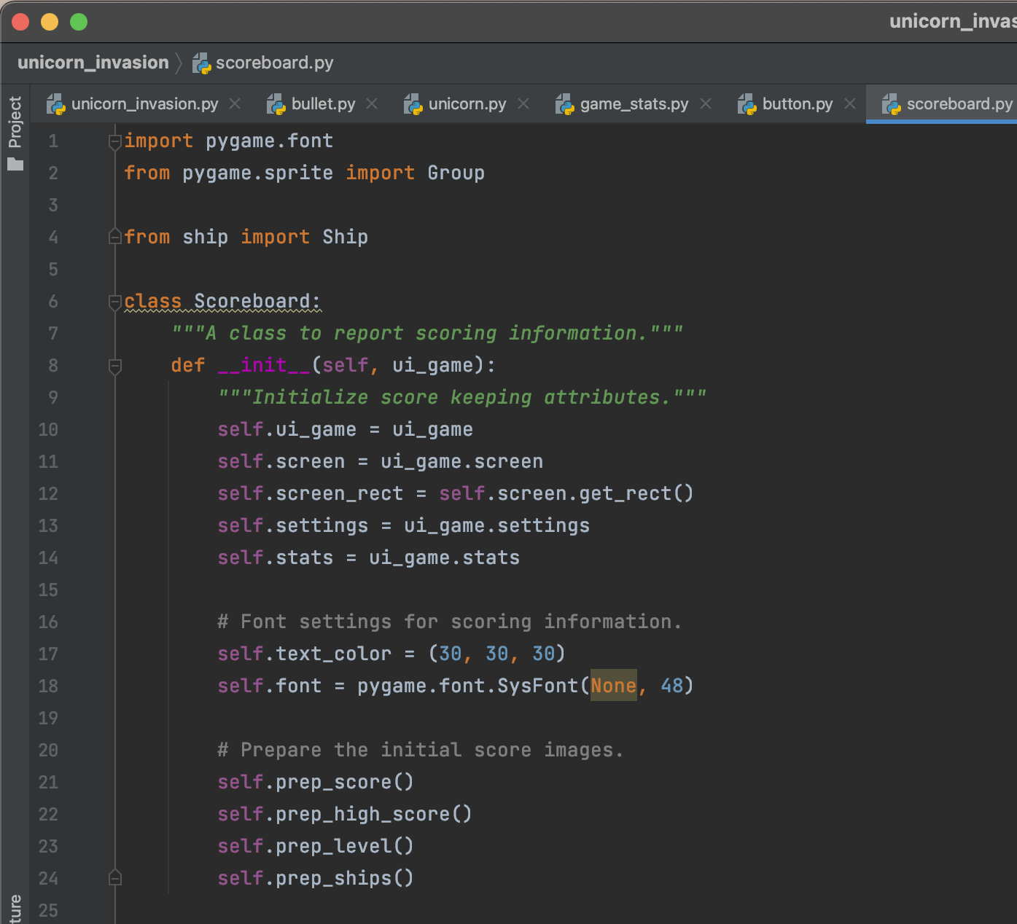
CLASS SCOREBOARD
class Scoreboard: This class is to keep score of the game while playing. It shows what score player has earned, also displays the level, and how many lives player has left.

Slide 8
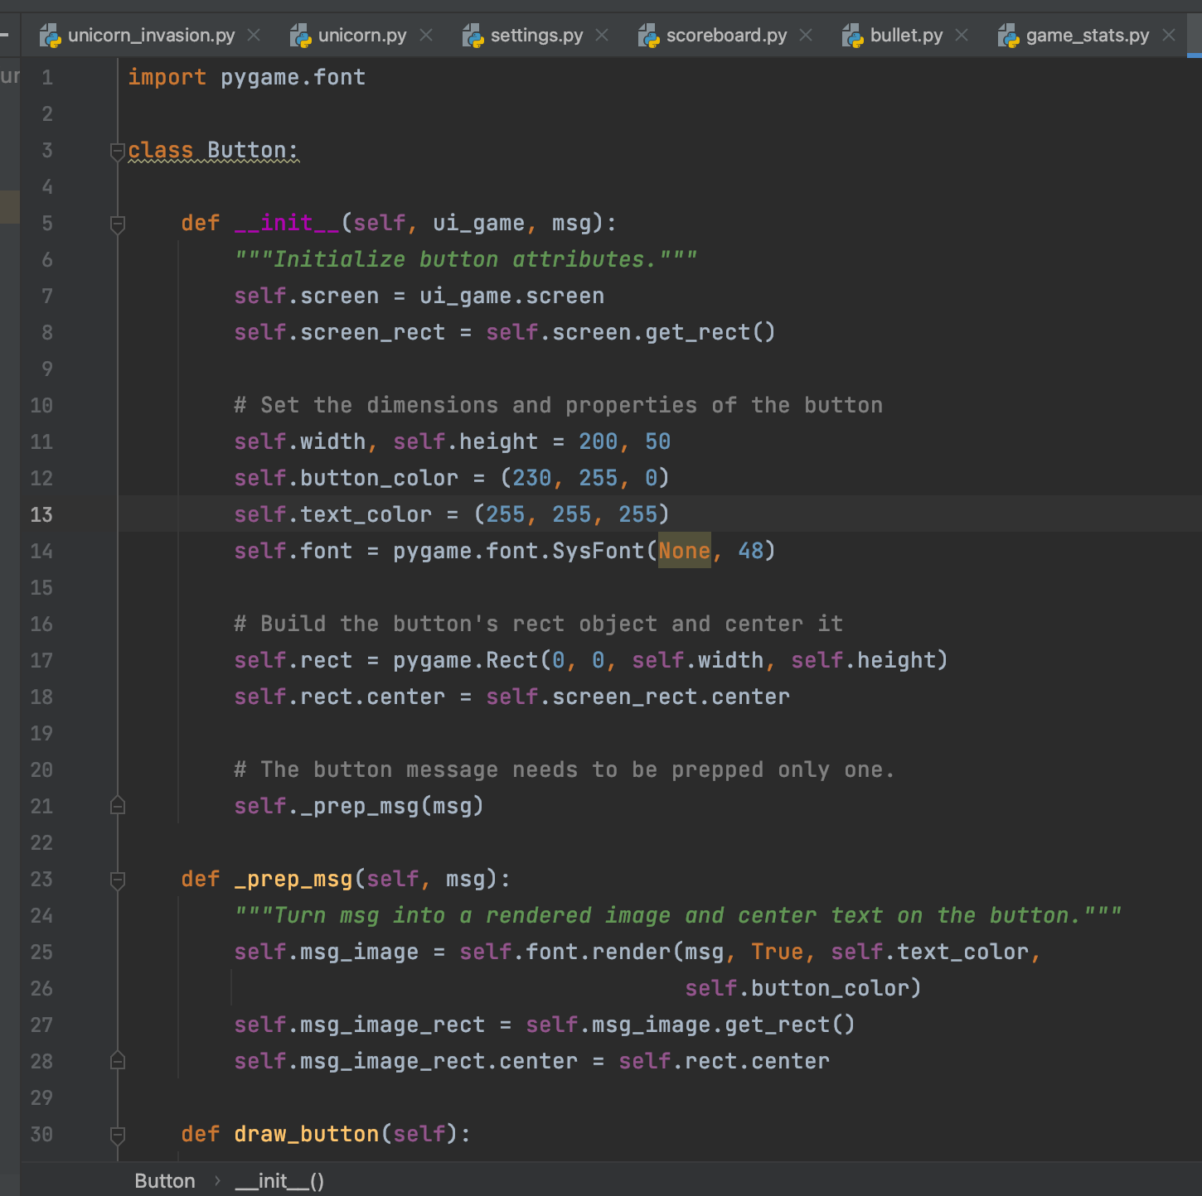
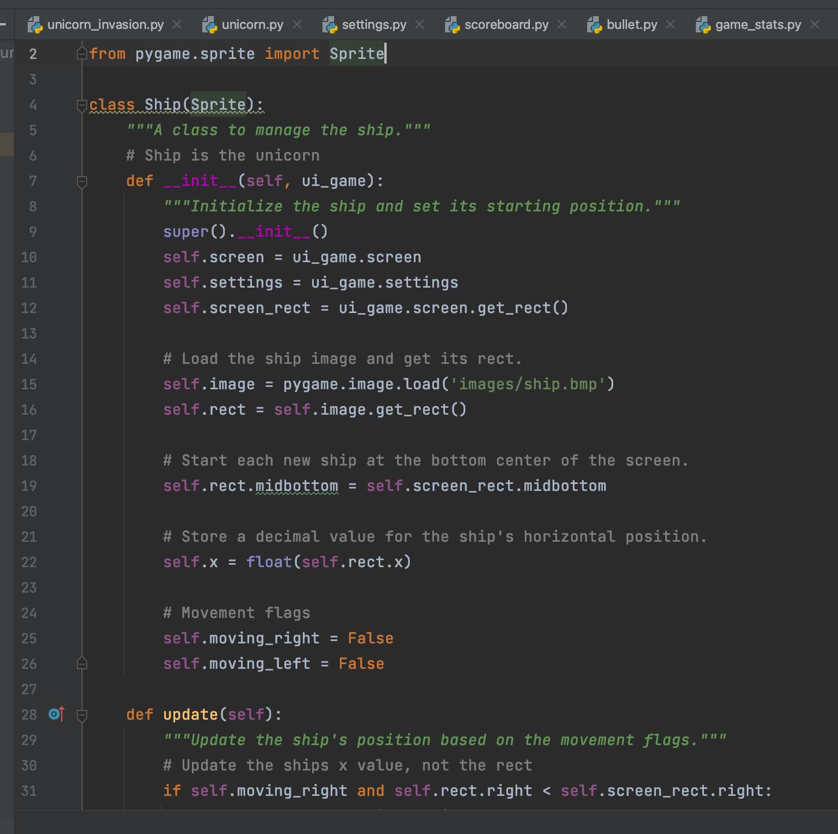
MORE CLASSES
class Button: This class is about the continue button and how to draw the button and prep it.
class Ship(Sprite): This class is to manage the ship and its starting position.

Slide 9
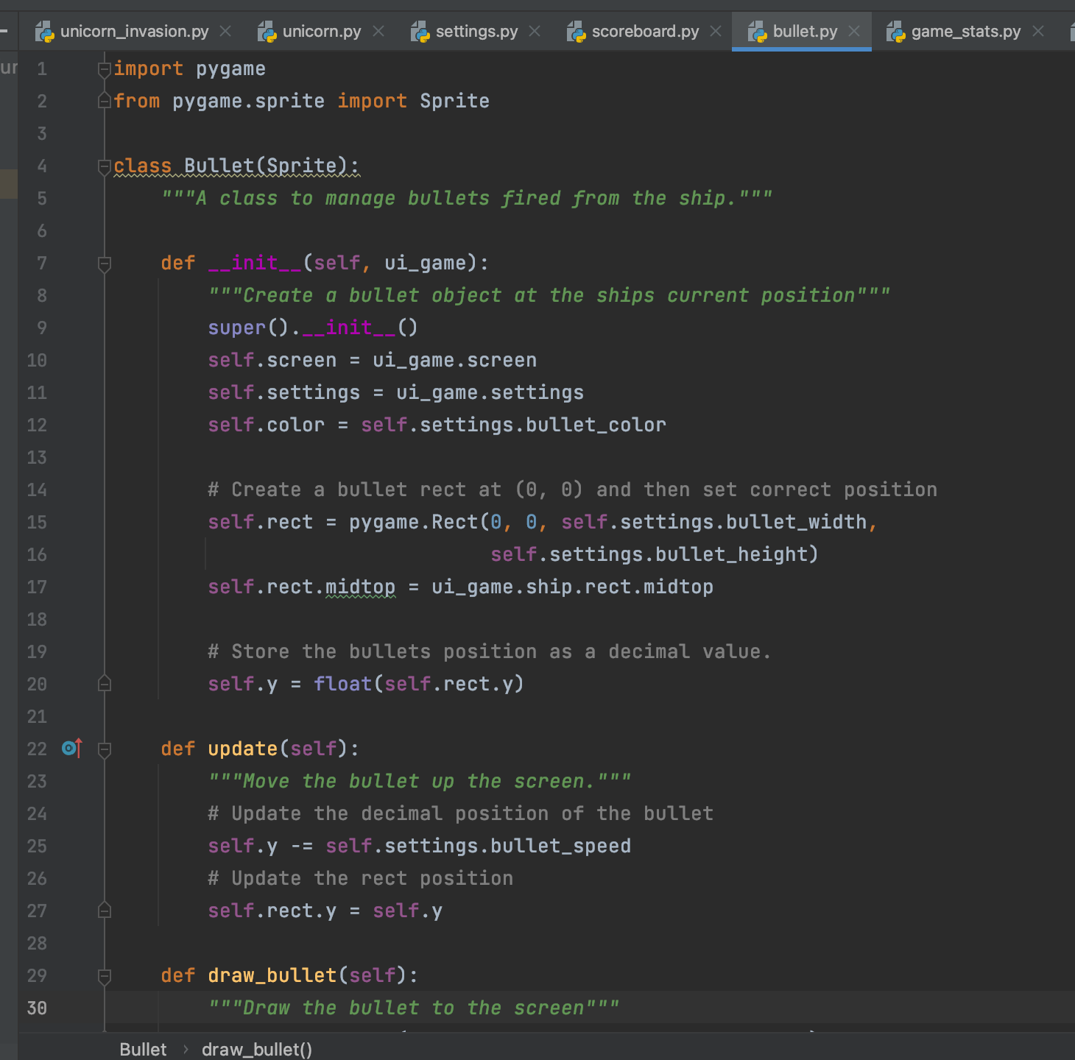
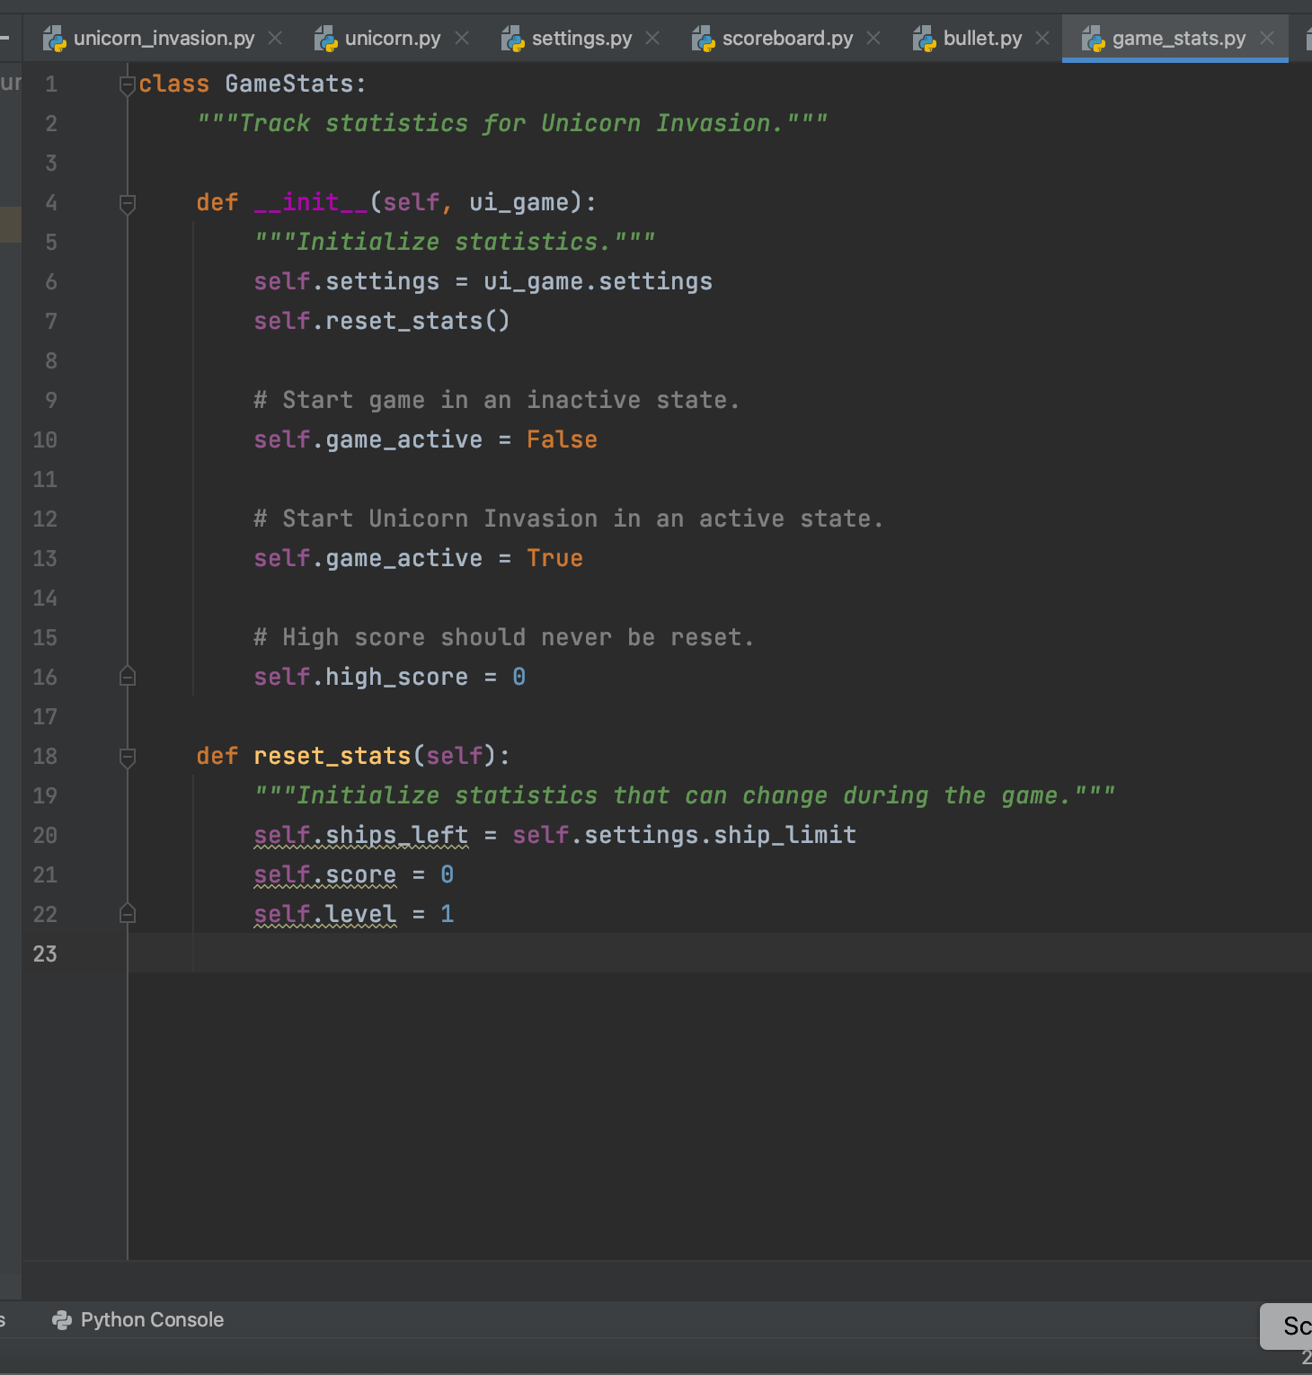
MORE CLASSES
class Bullet(Sprite): This class has the information about the bullets and how to draw them and how it moves.
class GameStats: This class is about the game statistics and when it’s active and inactive. It also has reset statistics.

Slide 10
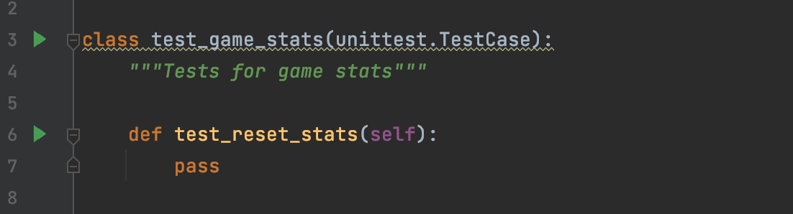
Test Case 1
This test case was used to test the game_stats file to see if it was working right.

Slide 11
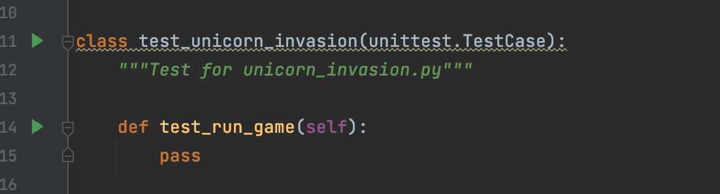
TEST CASE 2
This test case was used to test the unicorn_invasion.py file and see if it passed and it did.

Slide 12
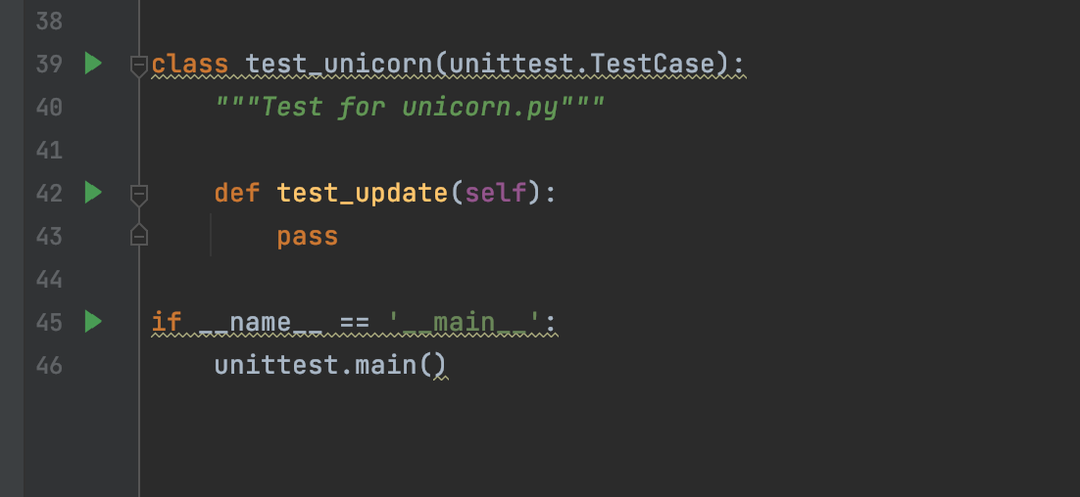
Test Case 3
This test case was used to test the file unicorn.py to see if it was working and the update section was working as well. It passed.

Slide 13
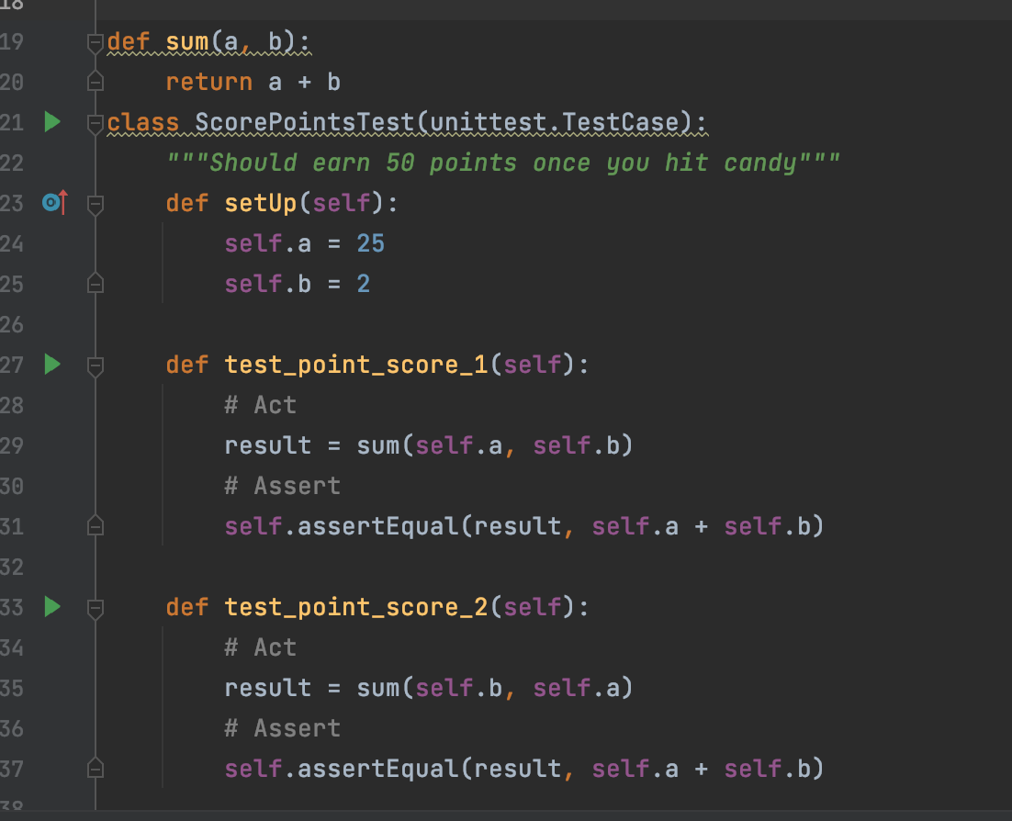
Test Case 4
Once a unicorn hits a candy, it says you earned 50 points. This test confirmed how many points you could earn.

Slide 14
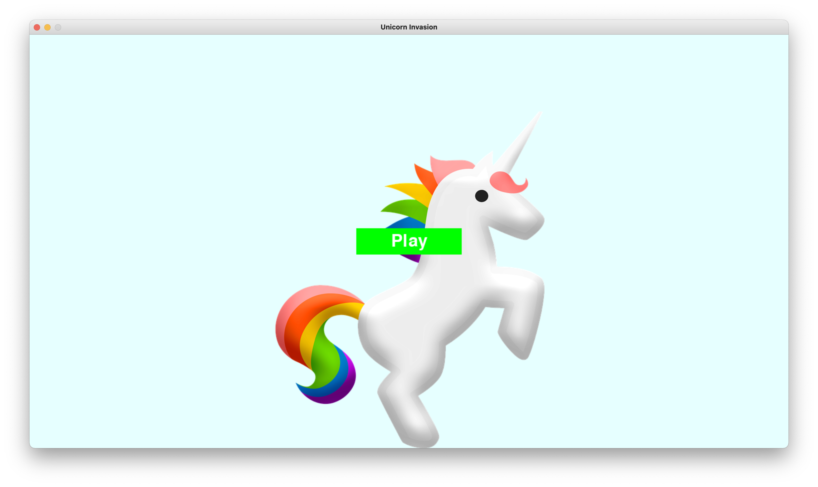
Mistakes
When I first started this project, I was going too fast, skimming over things and overall, not reading well and well, my code wasn’t working. That’s what happened with this picture above. That’s why I started all over and went slower and read carefully.
When running, there was just a huge unicorn with a play button and that was it. Nothing else worked.
FIRST ATTEMPT

Slide 15
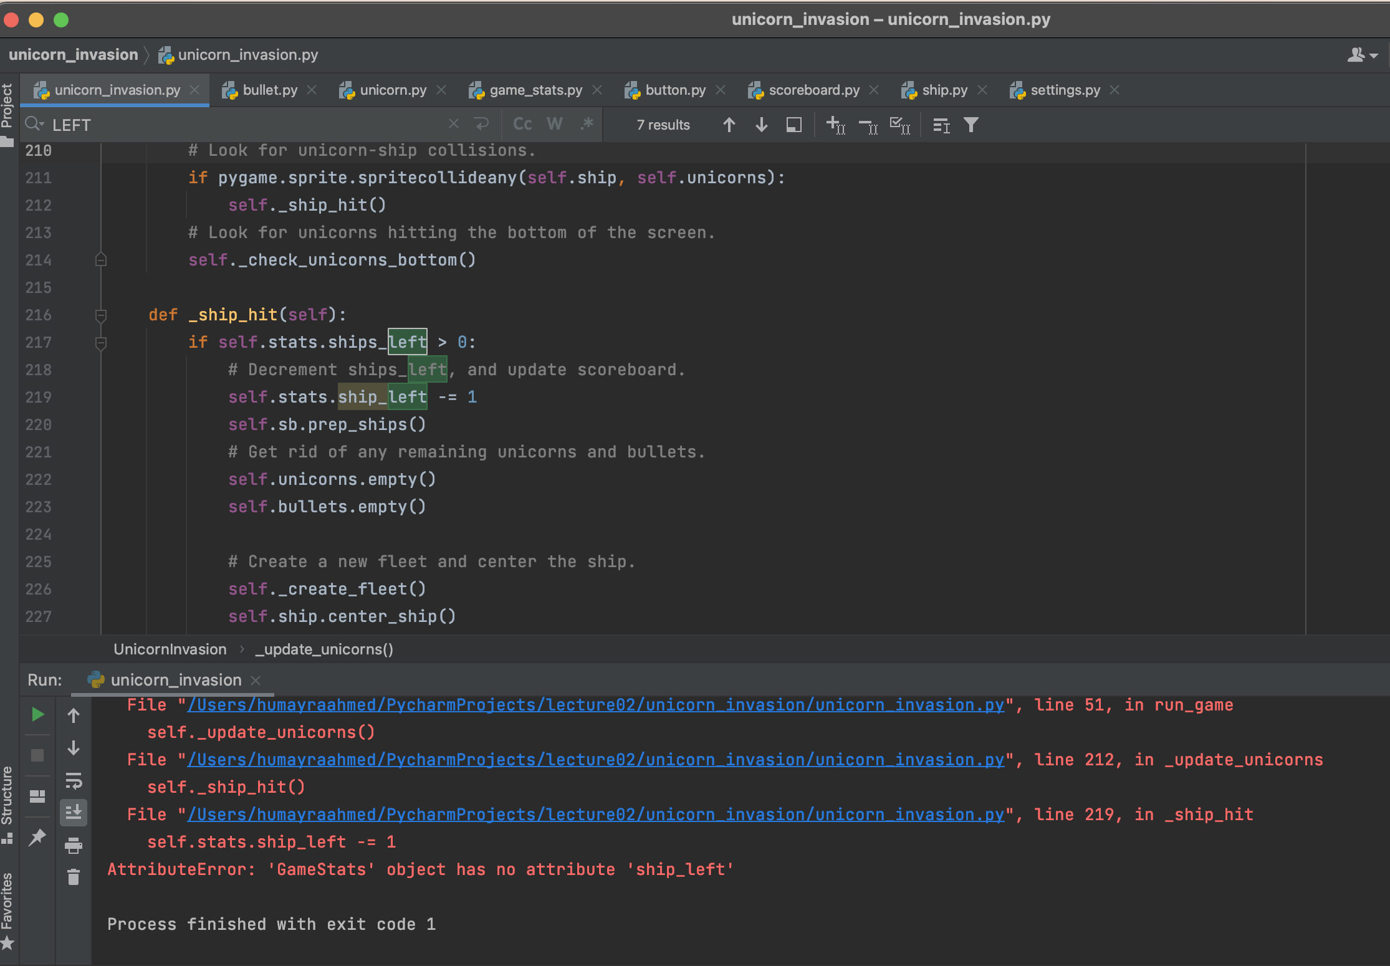
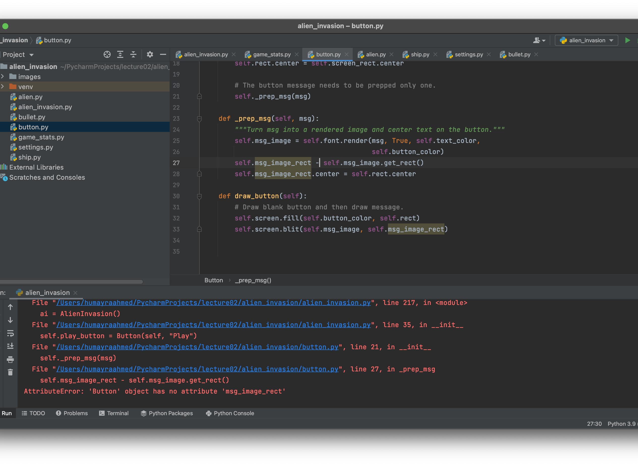
SMALL MISTAKES
The first picture, I made the mistake of forgetting an “s” at the end of “ship” in line 219 and although the game would run, when the candy hit the unicorn, the code would mess up. It took me a long time to realize why it was happening.
In the second picture, I put a – instead of an = sign and the code didn’t run.

Slide 16
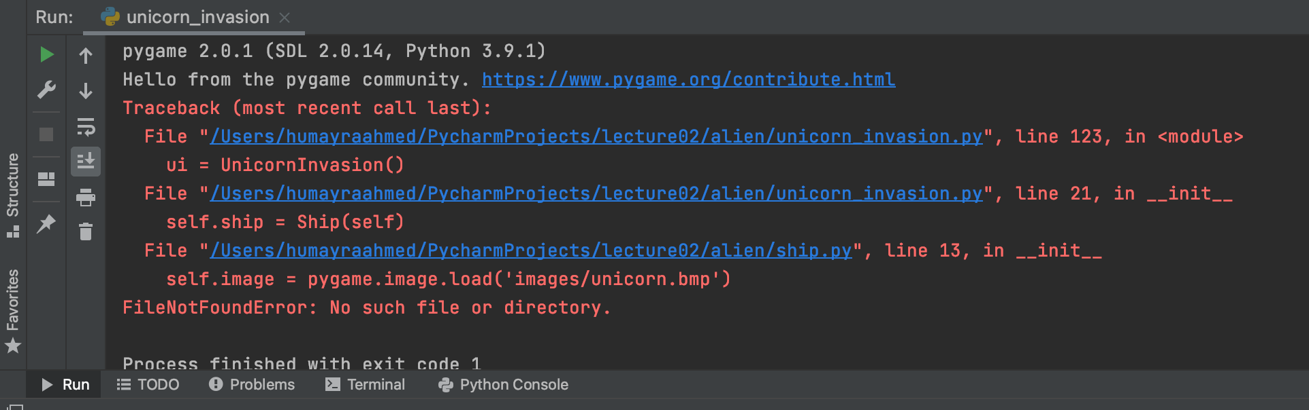
Exceptions
ImportError happened when doing the “from…import”. It happens when a file is not found. This shows ModuleNotFoundError: No module named ’file name’.
FileNotFoundError happened when a file/dictionary was not found. For this example, it happened with the .bmp file that did not exist.

Slide 17
LESSONS LEARNED
Pygame is pretty cool. Doing this project made me want to do another game, something different than this game.
I learned that Test Cases are a little tricky for me and I don’t really understand them but I learned a lot about the different kinds of them while researching it for this project!
I learned to take it slow. I tend to skim and read fast and because of that, I always miss important steps and that can go wrong very fast.

Slide 18

Project Location
https://github.com/humayraaa/unicorn

Slide 19

PNG IMAGES FROM PIXABAY.COM

